Slide 2
Trees
A lot of concepts and definitions follows from Chapter 5 : Introduction to Graph Theory
Syllabus
Properties of Trees
Rooted Trees and Binary Trees
Binary Search Trees

Slide 3
Trees : Properties of Trees
1) Characteristics of a Tree
A tree is a connected graph that contains no cycles. A tree has no loops and no
multiple edges. All trees are simple graphs.
2) Path Graphs
A tree that contains only vertices of degree one or two is called a path graph.
The length of a path graph is the number of edges in it.
3) Number of Edges
(Theorem 3.3) Let T be a tree with n vertices. Then T has n − 1 edges.

Slide 4
Trees : Properties of Trees
4) Spanning Subgraphs
The graph H is a subgraph of a graph G if H’s vertices are a subset of the G’s
vertex, its edges are a subset of the edge set of G, and each edge of H has the
same end-vertices in G and H.
H is called a spanning subgraph of G if the vertices of H are the same as the
vertices of G.
5) Spanning Trees
If H is a spanning subgraph which is also a tree, then H is said to be a spanning
tree of G. (G does not need to be a tree)

Slide 5
Trees : Properties of Trees
Spanning Trees (Figure)

Slide 6
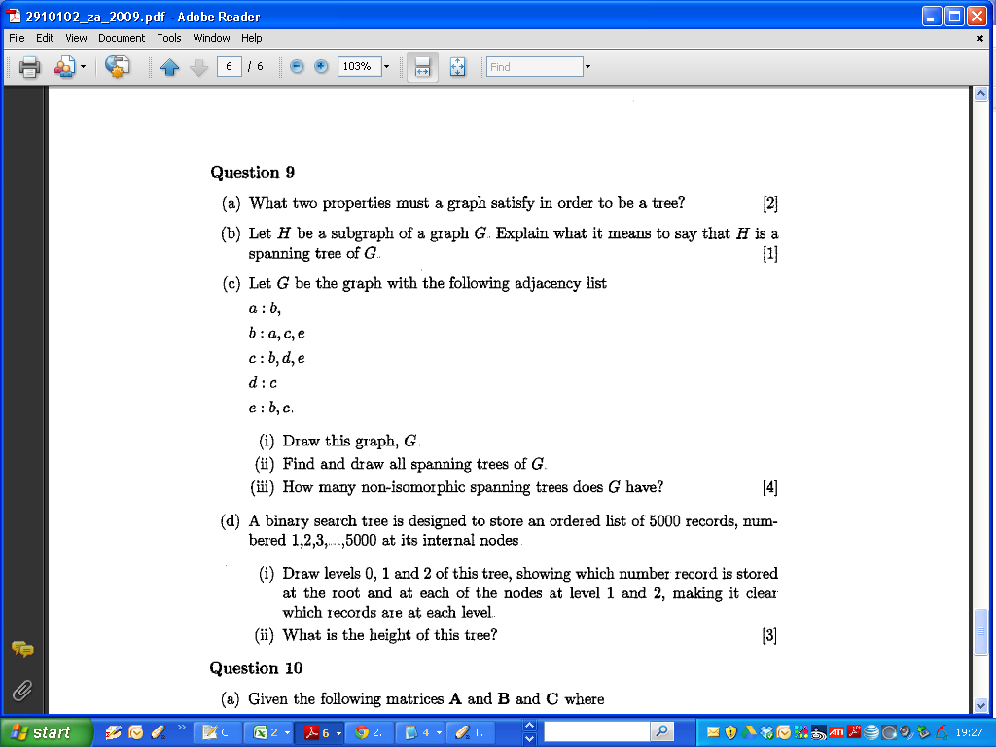
2009 Zone A Question 9

Slide 7
2009 Zone A Question 9

Slide 8
2009 Zone A Question 9

Slide 9
2009 Zone A Question 9

Slide 10
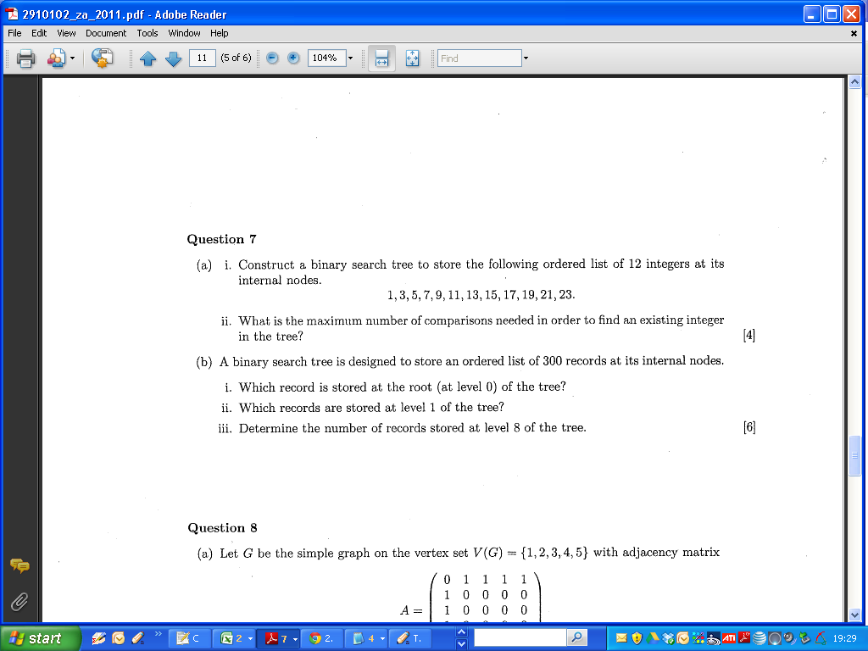
2011 Question 7

Slide 11
2011 Question 7

Slide 12
2011 Question 7 – Blank Slide

Slide 13
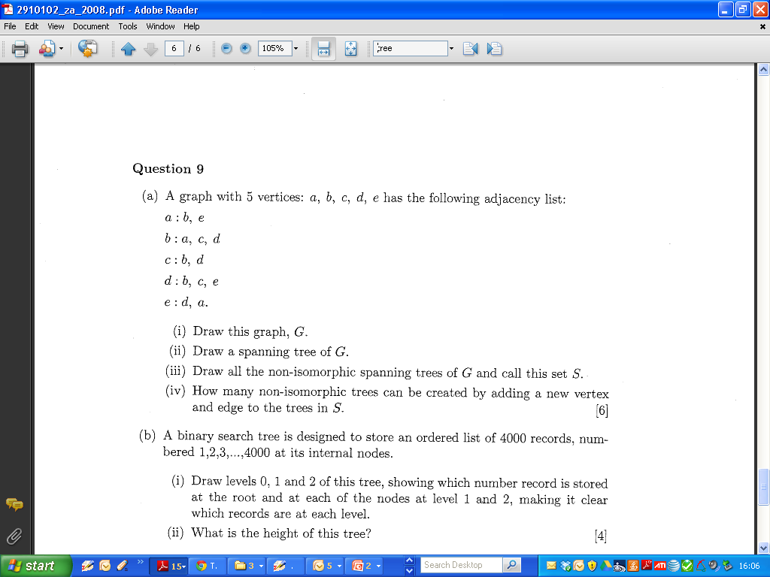
Trees : Properties of Trees 2008 Zone A Q9

Slide 14
Trees : Properties of Trees 2008 Zone A Q9

Slide 15
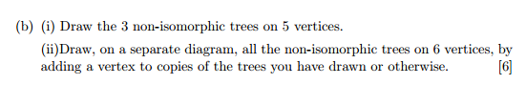
Trees : Properties of Trees 2008 Zone A Q9
Part IV
Examiner’s Commentaries : Then it is a question of adding another vertex and edge to each of these in all possible places and finally eliminating the isomorphic ones to do part (iv).
Simpler Exercise (2006 Q9)

Slide 16
Trees : Properties of Trees 2006 Zone A Q9

Slide 17
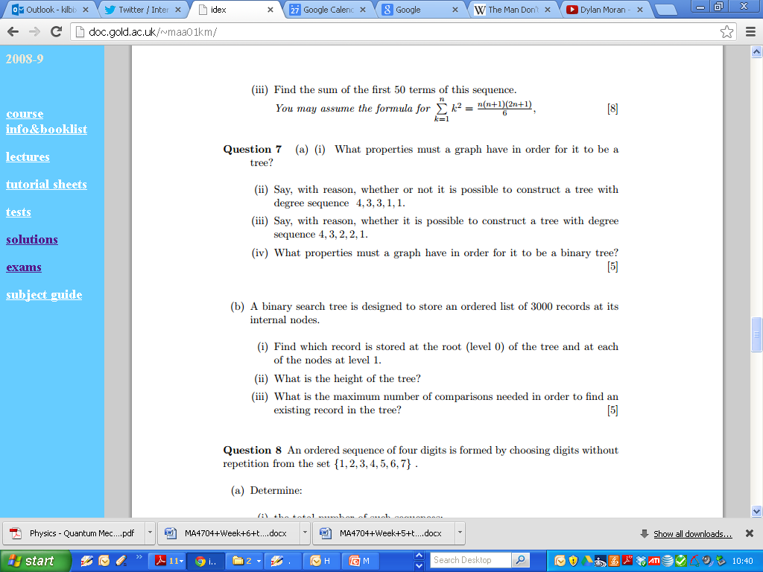
Trees : Properties of Trees

Slide 18
Trees : Properties of Trees

Slide 19
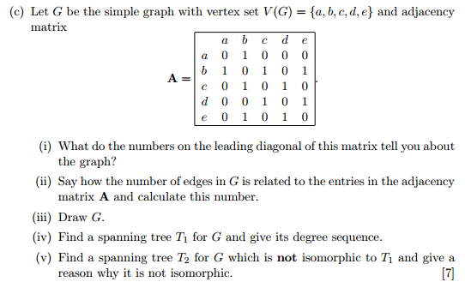
Trees : Properties of Trees (2005)

Slide 20
Trees : Properties of Trees

Slide 21
Trees : Properties of Trees

Slide 22
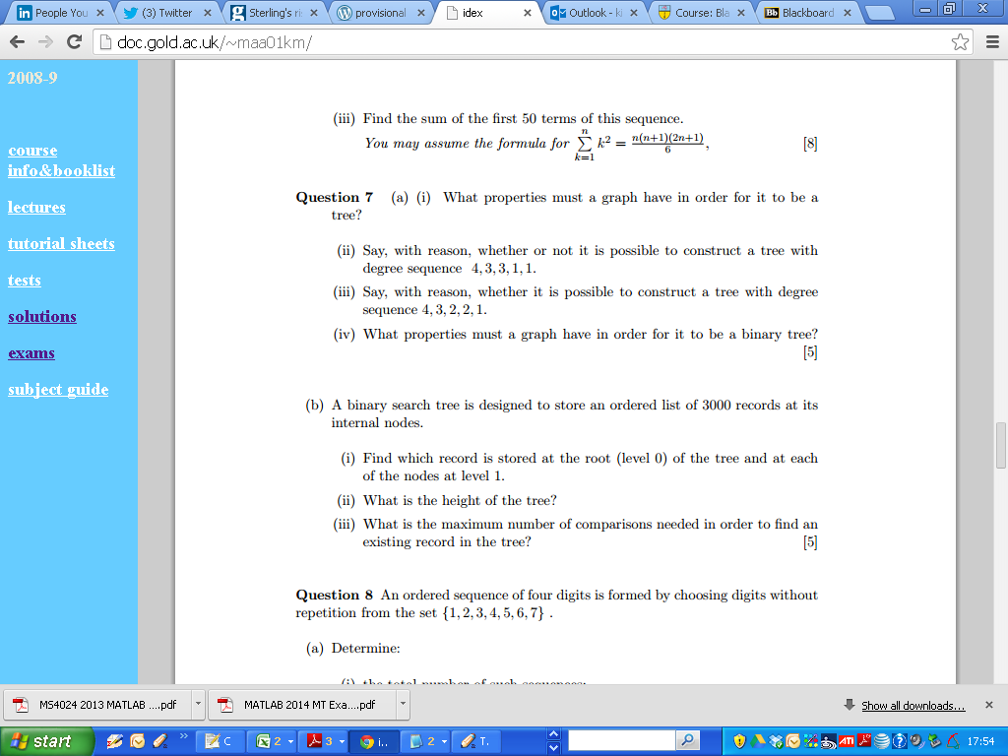
2004 Question 7 a

Slide 23
2004 Question 7 a

Slide 24
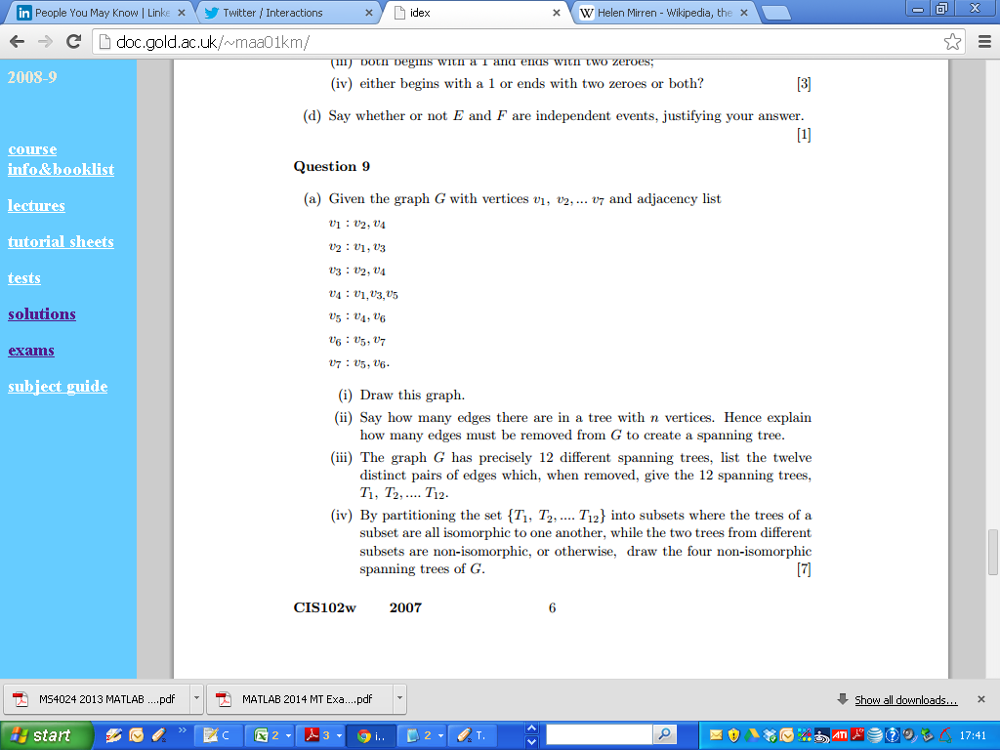
2007 Question 9

Slide 25
2007 Question 9

Slide 26
Trees : Rooted Trees and Binary Trees
Terminology (Page 37)
Root
Nodes
Key
Children and Parents
Ancestors and Descendants
Height

Slide 27
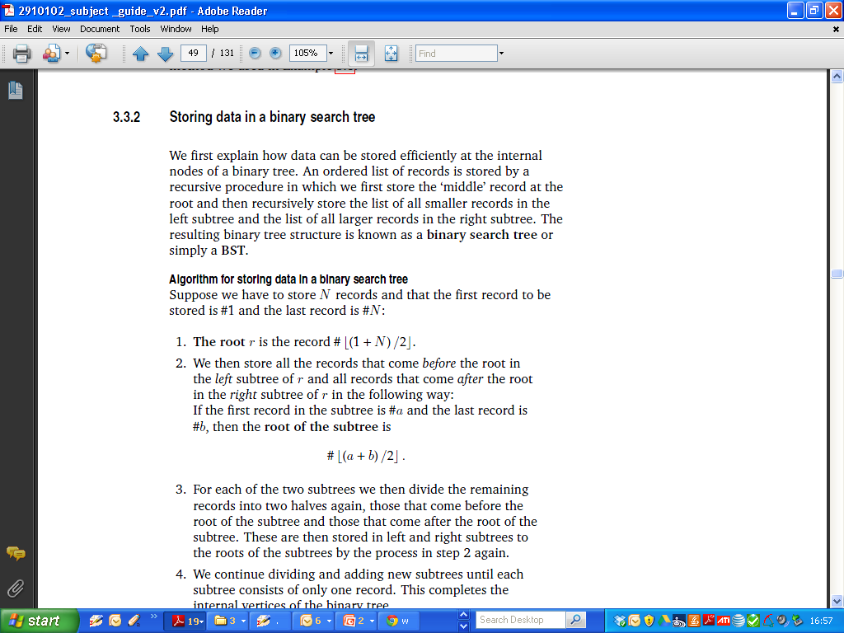
Binary Search Tree
A Binary Search Tree is a binary tree in symmetric order
Symmetric order means that:
every node has a key ( or number )
every node’s key is
  larger than all keys in its left subtree
  smaller than all keys in its right subtree
The root r is the record

Slide 28
Binary Search Tree
If the first record in the subtree is #a and the last record is #b, then the root of
the subtree is

Slide 29
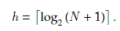
Trees : Binary Search Trees
The height h of a binary search tree with N records stored at internal nodes is

Slide 30
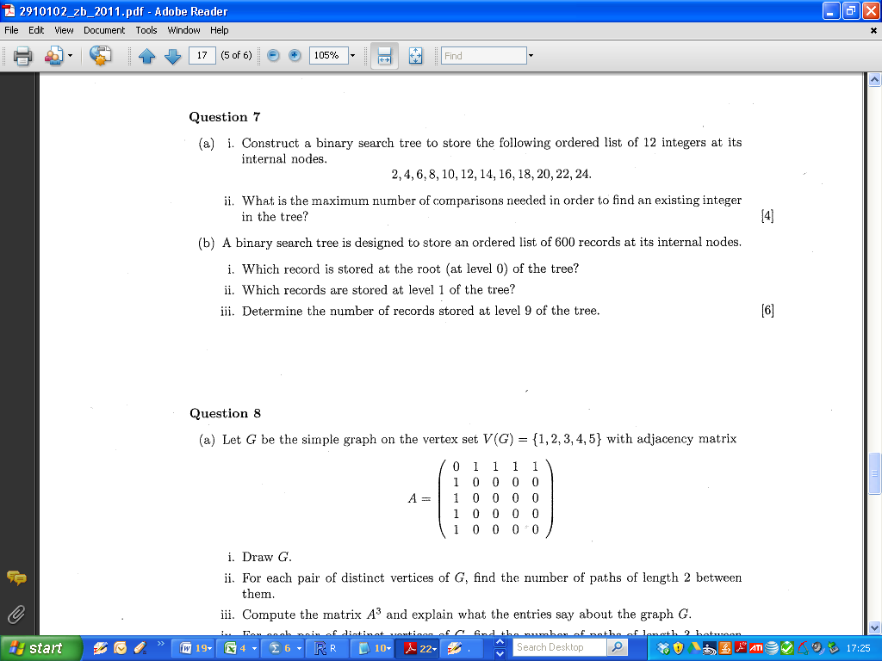
Trees : Binary Search Trees (2011 Zone B)

Slide 31
Trees : Binary Search Trees

Slide 32
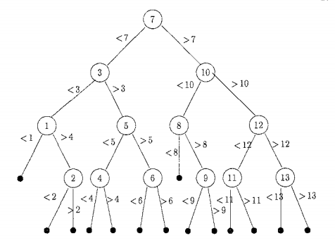
Binary Search Trees

Slide 33
Trees : Binary Search Trees (2004)

Slide 34
Trees : Binary Search Trees

Slide 35
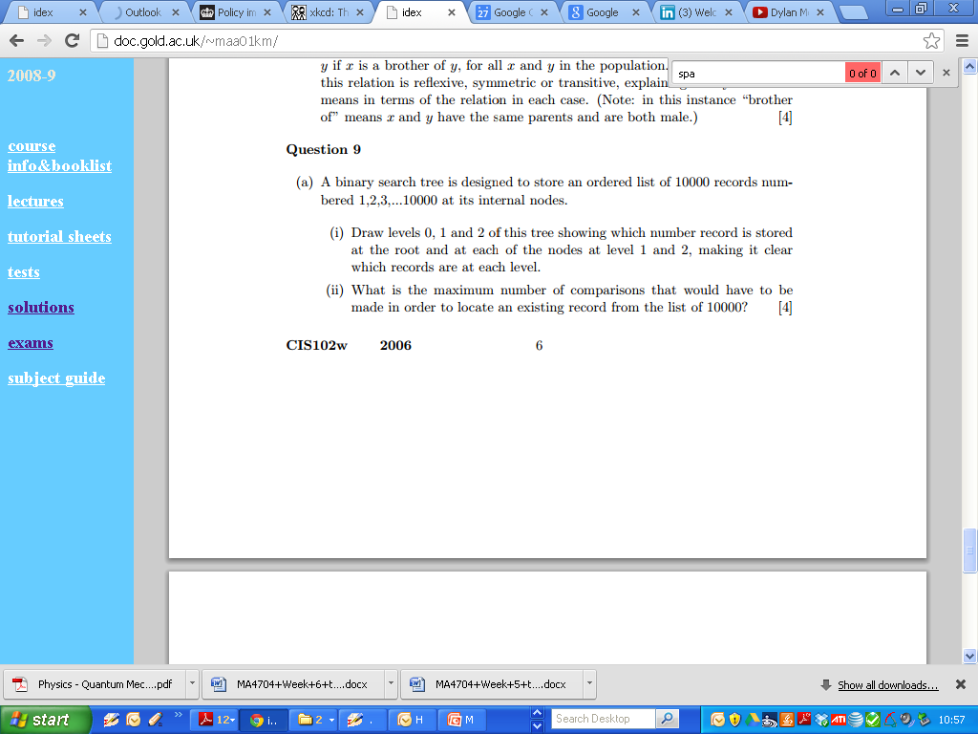
Trees : Binary Search Trees

Slide 36
Trees : Binary Search Trees (2006)

Slide 37
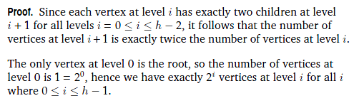
Trees : Binary Search Trees

Slide 38
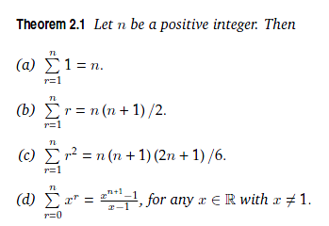
Trees : Binary Search Trees

Slide 39

Trees : Binary Search Trees

Slide 40
Trees : Binary Search Trees

Slide 41
2004 Question 7 b

Slide 42
2004 Question 7 b

Slide 43
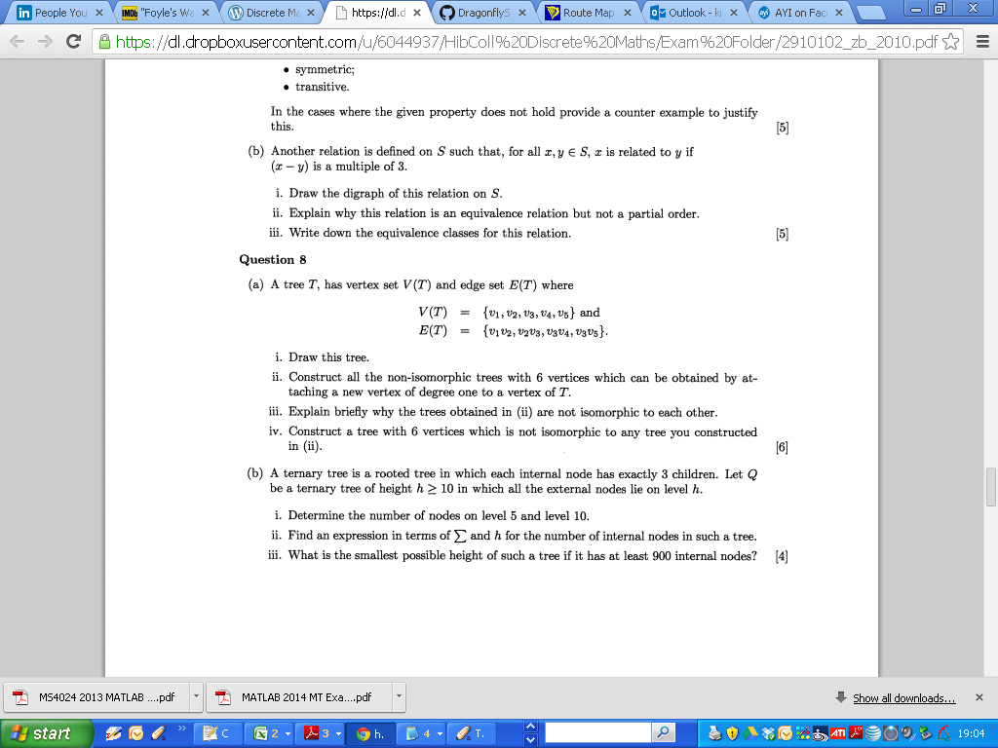
2010 Question 8

Slide 44
2010 Question 8

Slide 45
2010 Question 8

Slide 46
2010 Question 8

